Slide 1
More Applications of Pharmacology & Toxicology
Week 3

Slide 2
Environmental Toxicology
Study of the hazardous effects that poisons in the environment have on human health
4 billion tons of waste are produced annually from mining, agriculture, industry, municipal sewage
Daily 2.5 kg (4 lb) domestic solid waste per capita
Only 10% of this waste is disposed of in environmentally safe manner
5 million natural & man-made chemicals; 80,000 synthetic chemicals
WHO epidemiological data: 90-95% cancers are "environmentally related"
Environmental toxicology can be divided into two subcategories:
Environmental health toxicology: Study of the adverse effects of environmental chemicals on human health.
Ecotoxicology which focuses upon the effects of environmental contaminants upon ecosystems & constituents thereof (fish, wildlife, etc).

Slide 3
Threshold Dose: dose at which response/effect observed
Subthreshold doses
NOEL = no observable effects level
NOAEL = no observable adverse effects level
SNARL = suggested no adverse response level
LOEL = lowest observable effect limit
TLV = threshold limit value

Slide 4
Toxicant Distribution
Lymph: capillaries, nodes, special lymphoid structures (tonsils, spleen, thymus), peripheral lymphocytes
Cardiovascular: heart, arterial vessels, venous vessels, capillaries
Nervous system: brain/CNS, PNS
Organs handling xenobiotic biotransformation, excretion: liver, kidney

Slide 5
Target Organ Toxicity Examples
Organ | Toxicant | Mechanism | Toxicity
heart | fluorocarbons (Freon) | sensitizes heart to epinephrine? | decreased heart rate, contractility, and conduction
 | carbon monoxide (CO) | interferes with energy metabolism | myocardial infarction. increase or decrease in heart rate
 | cobalt (Co) | competes with Ca²⁺ | heart failure
testis | lead (Pb) | mutations in sperm? | decreased male fertility, increased spontaneous abortions
 | carbon disulfide (CS₂) | CNS effect on ejaculation | reduced sperm counts
ovary/ uterus | solder fumes | unknown | increased spontaneous abortions
 | polycyclic aromatic hydrocarbons (PAHs) | unknown | damaged oocytes
eye | Busulfan (chemotherapeutic agent) | alters mitosis in lens cells? | formation of cataracts
 | methanol (CH₃OH) | produces optic atrophy | permanent visual impairment, blindness

Slide 6
Environmental Toxicants
Pesticides
insecticides
herbicides
fungicides
rodenticides
Plastics
Metals
As, Cr, Be, Hg, Pb, Ni, Cd
Organic Solvents
methanol, benzene + alkylbenzenes (toluene, xylenes), carbon disulfide, ethanol, ink/paint solvents (methyl ethyl ketone)

Slide 7
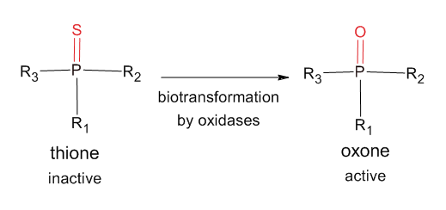
Pesticides: Insecticides
most are neurotoxicants to insects sometimes to humans
entry routes include skin, lung, oral (GI tract)
Organophosphates
parathion, diazinon, malathion: specific targets for arthropod acetylcholinesterase
California Mediterranean fruit fly malathion spraying
Carbamates
aldicarb, carbaryl, propoxur
also anti-cholinesterases

Slide 8
Pesticides: Insecticides
Acute toxicity
OPs: DUMBELS=diarrhea, urination, miosis (pinpoint pupils), bronchospasm, emesis (vomiting), lacrimation (tearing), salivation
recovery periods vary from a few days to weeks for mild/moderate exposure to a few months for severe
death can occur usually within 24 h from untreated exposure
Carbamate exposures resolve more quickly because cholinesterase inhibition is reversible
Chronic toxicity
Organophosphate-induced delayed neuropathy (OPDIN) for select organophosphate: predominantly motor paralysis

Slide 9
Pesticides: Insecticides
Organochlorines
dichlorodiphenyltrichloroethane (DDT)
neurotoxic: either stimulatory or inhibitory: interfere with K⁺ or Ca²⁺; poorly absorbed in skin
very stable (long-lived) chemicals: reason for ban
accumulates in lipid stores (biological magnification)
phase I: dechlorinations, demethylation
phase II: glutathione
acute toxicity: CNS—headaches, dizziness, tremors, convulsions
chronic toxicity: memorly loss, personality changes, low sperm count

Slide 10
Pesticides: Herbicides
mechanism of toxicity is by interfering with hormonal systems regulating growth or promoting dehydration/dessication
weak acute toxicity to humans
chronic exposure?
entry routes include skin, lung, oral (GI tract)
Bipyridyls
Chlorophenoxy compounds
DNP

Slide 11
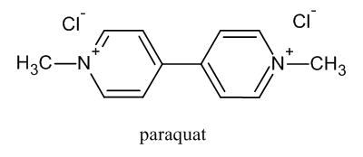
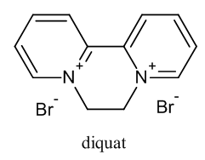
Pesticides: Herbicides
Bipyridyls
diquat, paraquat are representative
act to desiccate the plant
routes of entry: skin, lungs, GI tract
acute toxicity: damages pneumocytes to decrease O₂/CO₂ gas exchange
metabolism not well understood
urinary and fecal route elimination
acute toxicity (paraquat): anoxia, coma, organ (liver, kidney, lung) damage; ingestion of concentrated product causes death

Slide 12
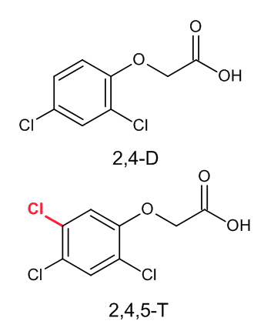
Pesticides: Herbicides
Chlorophenoxy Compounds
2,4-dichlorophenoxyacetic acid (2,4-D), 2,4,5-trichlorophenoxyacetic acid (2,4,5-T)
Agent Orange is a 50:50 mix of 2,4-D & 2,4,5-T
Herbicidal action through uncontrolled plant growth
these compounds alone are weakly toxic to humans, but the presence of TCDD* in trace amounts in manufacture gives it (controversial) high toxicity
routes of entry: skin, lungs, GI tract
metabolism and excretion data wanting
acute toxicity: sweating, oliguria, peripheral neuropathies, muscle weakness, dizziness, headache, vomiting, fatigue
TD₅₀ ~ 50-60 mg/kg; LD₅₀ ~ 300 mg/kg
* TCDD is addressed in later slide

Slide 13
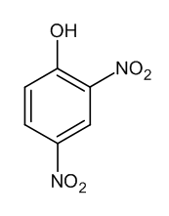
Pesticides: Herbicides
2,4-Dinitrophenol
DNP absorbed by skin, lungs, GI tract
toxicity is by inhibition of ATP synthesis: symptoms include tachypnea, tachycardia, sweating, coma, development of cataracts
carcinogenic: feature of aromatic nitro and amine compounds
It had been used as an anti-obesity drug in the 1930s but no data on toxicokinetics is available at all
US EPA now considers it environmental contaminant

Slide 14
Pesticides: Fungicides
Many of these chemical forms are no longer in use but could still be encountered in the environment
Fungicides in general are still widely used because fungi themselves produce deadly fungitoxins such as phallotoxins (Amanita) and aflatoxins (Aspergillus)
Hexachlorobenzene
Organomercurials
Phthalimides
Dithiocarbamates

Slide 15
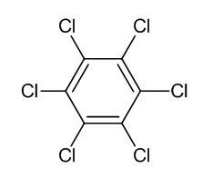
Pesticides: Fungicides
Hexachlorobenzene
Prior to 1960 used on seed grain before planting to prevent fungal infestation
Toxic responses: skin blister, hepatomegaly, thyroidmegaly, arthritis, osteomyelitis, osteoporosis
HCB toxicokinetics unknown
Persistence in environment similar to other organochlorines (DDT)
Biomagnification quite likely

Slide 16

Pesticides: Fungicides
Organomercurials
Methylmercury is representative
Methylmercury had been used to treat seed grains
In past poisonings showed severe neurotoxic effects; crosses blood-brain barrier
Linked to severe effects in fetal development and to autoimmune disease
Strong evidence of bioaccumulation in food chains

Slide 17
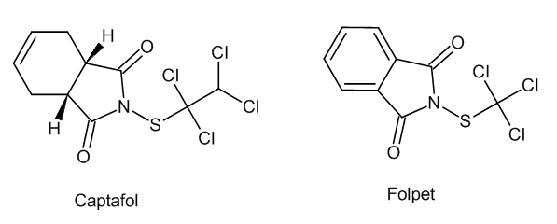
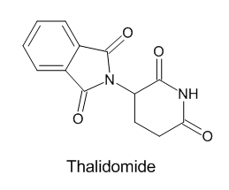
Pesticides: Fungicides
Phthalimides
Captafol, Folpet are representative
Strong structural similarity to thalidomide*
Percutaneous & respiratory routes of entry
Biotransformation rapid, elimination in urine & feces
Acute toxicity: irritant, allergic contact dermatitis
Chronic toxicity: mutagenesis, carcinogenesis, teratogenesis (all lab animals)
LD₅₀: 10,000 mg/kg (rats)
* Thalidomide causes severe and fatal birth defects but apparently has limited medical uses

Slide 18
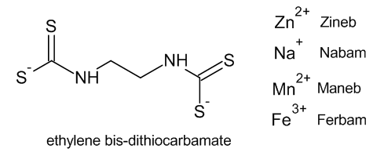
Pesticides: Fungicides
Dithiocarbamates
ethylene-bis-dithiocarbamate (EBDC) representative
Ferbam (Fe³⁺), Maneb (Mn²⁺), Nabam (Na⁺), Zineb (Zn²⁺) are metal cation forms
dithiocarbamate derivatives also used as insecticides (AChase inhibitors) & in chemical/rubber industries
routes of entry: skin, lungs, GI tract
distribution, biotransformation, excretion all "rapid"
toxicity: contact dermatitis, irritant, CNS depression animal studies show mutagenesis/carcinogenesis potential

Slide 19
Pesticides: Rodenticides
Insecticides, herbicides and fungicides are chemicals synthesized so as generally not to have toxicity to humans when "applied using manufacturer's recommendations
But many of the toxic chemicals used to control pests that are mammalian (rats, mice) have moderate to strong toxicity to humans
Adult exposures are accidental percutaneous and respiratory entry routes
But exposure to children can include accidental ingestion
Anticoagulants
Cell Respiration Inhibitors/Uncouplers
Vasoconstrictors
Diabetogenics

Slide 20
Pesticides: Rodenticides
Anticoagulants
Warfarin (coumadin) is representative
Anticoagulants interfere with vitamin K recycling: vitamin K is used to synthesize proteins required for blood clotting (prothrombin)
half-life directly dependent on plasma protein binding
warfarin shows 97% binding, t_{1/2} = 40 h; heparin has little binding, t_{1/2} = 1 h
Acute toxicity: nosebleeds, bruising, internal hemorrhaging, GI tract bleeding, stroke

Slide 21
Pesticides: Rodenticides
Cell Respiration Inhibitors
sodium fluoroacetate (CF₃COONa) [SFA], fluoroacetamide (CF₃COONH₂) representative
These block enzymes in Krebs (TCA) cycle, which block ATP production
Acute toxicity: nausea, vomiting, abdominal pain, increased heart rate, kidney failure, coma, death (LD₅₀ ≤ 10 mg/kg SFA)

Slide 22
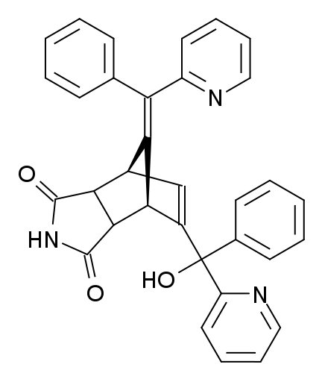
Pesticides: Rodenticides
Vasoconstrictors
norbormide representative
rings of smooth muscle at the entryways of bifurcating arterial vessels contract without the normal autonomic control
chemical and nervous signals typically control smooth muscle in arteries and arterioles to direct blood flow to tissues/organs in a prioritized way; poisons can override this control
poisons can cause irreversible vasoconstriction, causing ischemia leading to necrosis, then death
5-15 mg/kg rats up to 300 mg/kg exposure not toxic in humans
mechanism of action appears to be it keeps myocyte Ca²⁺ channels open, not allowing muscle to relax

Slide 23
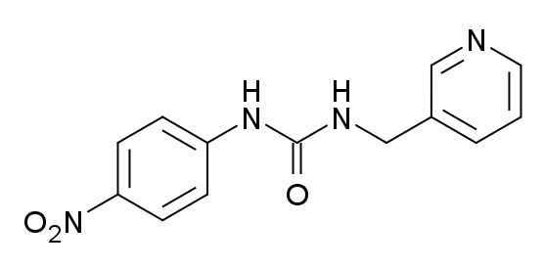
Pesticides: Rodenticides
Diabetogenics
pyriminil representative
Mammalian pancreases produce insulin, which regulates the entry (transport) of glucose into many cell types
Note that cell types/tissues/organs such as the brain do NOT depend on insulin to obtain glucose, a vital physiological characteristic for tissues that depend on a constant, high supply of glucose
Pyriminil apparently targets and kills the beta cells of the pancreas which produce insulin: if insulin can no longer be produced, cells dependent on insulin (skeletal muscle, adipose tissue, etc) for transport of glucose into the cells no longer get glucose, so the cells and their tissues die
Pyriminil is no longer approved for use in US (EPA); it and other diabetogenic rodenticide with toxicity to humans (same mechanism) will likely never be approved
Acute toxicity would manifest with neurological disorders caused by transient hypoglycemia

Slide 24
Plastics
Plastics are any polymeric substance that can be shaped by heat or pressure to the form of a cavity or mold
Thermoplastics make 80% of all plastics and can be remelted or remolded (polyethylene, polypropylene, polyvinylchloride, polystyrene); thermosetting plastics cannot be remelted or remolded
Most are not degradable, biologically or by UV radiation (under sunlight)
Only 9% (2.8 million tons) of all plastic was recycled in 2012
The burning of plastic as a means of disposal, which happens in many developing countries, produces worse toxicants, such as dioxane, a known carcinogen and absorbed by inhalation

Slide 25
Metals
80 metals (e.g., Fe, Mg, Zn) are required in human biochemistry, but others (e.g., Pb, Hg, Cd) are toxic
Routes of entry are either by ingestion or inhalation
Elimination routes typically in urine, but can be excreted back into intestinal lumen
Arsenic (As)
Chromium (Cr)
Mercury (Hg)
Lead (Pb)
Nickel (Ni)

Slide 26
Metals: Arsenic (1 of 2)
ubiquitous: used paints/dyes, metals, drugs, soaps, semiconductors, weed killers (used heavily in golf courses until 2013), animal medicines (!)
soil levels: 10 mg/kg, groundwater: < 1 µg/L
volatile forms in air: ~20-30 ng/m³ in urban areas
dietary intake: 1-20 µg/day; grains, fruit, vegetables
inorganic arsenic
As(III)/As³⁺: As₂O₃, As(OH)₃
As(V)/As⁵⁺: As₂O₅, AsO (OH)₃
organic arsenic
monomethylarsonic acid (CH₃AsO₂OH) [MMA]
dimethylarsonic acid [(CH3)2AsO–OH) [DMA]

Slide 27
Metals: Arsenic (2 of 2)
absorption is usually through the GI tract, but inhalation also possible
biotransformation: inorganic forms reduced & methylated to organic forms
elimination: usually via urine (t_{½} about a few days) 70-100% organic form, 0-30% inorganic
acute toxicity: anorexia, hepatomegaly, cardiovascular failure, death (LD threshold > 70 mg)
chronic toxicity: CNS/PNS neuropathologies, muscle weakness, typically shows up in horizontal white bands in nail beds (Mee's lines)
carcinogenesis: oral ingestion of drinking water when several hundred micrograms per liter induces bladder, liver, skin cancers

Slide 28
Metals: Beryllium
metal used in alloy production, released in coal combustion, volcanic ash
if inhaled, acute toxicity produces lungs that are fibrotic, smaller in size, with cyst development ("honeycomb lung"); skin contact causes a dermatitis
oxides in H₂O insoluble, but Cl, F, NO3, SO4 forms soluble
poorly absorbed in skin and GI tract
carcinogenic: beryllium particles can reside in particles for years

Slide 29
Metals: Cadmium
Used in both manufacturing processes and household products
typically inhaled and produce pulmonary edema
increased absorption in GI tract may be associated with low iron levels
acute toxicity of ingested Cd shows as nausea/vomiting, abdominal pain
chronic exposure leads to nephrotoxicity (to tubules)
binds to plasma proteins, concentrates in the kidneys, and with a half-life of 30 years (!) (0.001% excreted per day)
Ni-Cd (ni-cad) battery workers in UK and Sweden found to be at increased risk for prostate and lung cancers

Slide 30
Metals: Chromium
Most exposure is to workers manipulating Cr in manufacture: stainless steel, paint pigments, wood preservatives, leather tanning
Cr³⁺ involved in metabolism of glucose, fat, protein
Cr⁶⁺ can be reduced to Cr³⁺ but if it enters cells it may exert its most toxic effects
routes of entry: oral, inhalation
distributes to all tissues
urinary elimination
acute toxicity: damage to GI tract, immune system, hematopathies
carcinogenesis
no reliable results by oral route
respiratory system cancers for workers by inhalation
skin exposure: contact dermatitis, skin ulcers

Slide 31
Metals: Lead
ubiquitously found ceramics, paints, automobile exhausts
exists as Pb⁰, Pb²⁺ (typical inorganic) and Pb⁴⁺ (usually organic)
absorbed by inhalation or ingestion
in GI tract:
passive diffusion in trans- and paracellular pathways
active transport for systems to absorb calcium & iron
binds to RBCs in blood
accumulates in bone (Ca²⁺ replacement) where it has a half-life for 20 years
acute toxicity (0.1 mg/dl) produces pathologies in blood, kidneys, and CNS
children particularly susceptible: Pb-based encephalopathy, appetite loss, ataxia, coma, death
known carcinogen in animals, suspected in human

Slide 32
Metals: Mercury
Hg in all forms (Hg⁰ liquid metal, inorganic salt, organic forms) is toxic
Uses: industrial catalysts, batteries, pigments, preservatives, switches, CFLs, fungicides
Organic-Hg absorbed by GI tract and accumulates in brain
Inorganic Hg salts accumulate in kidneys
Excretion is in urine or feces (depends on form)
Acute toxicity: Hg⁰, organic-Hg: CNS, kidney
Mechanisms of toxicity range from complexing with thiols, induction of oxidative stress, perturbing Ca²⁺ mobilization

Slide 33
Metals: Nickel
common in alloys, batteries, coins, electronics, food processing
70-150 µg/day ingestion from food & water
absorption in lungs, but less so in GI tract
binds to plasma proteins
absorbed Ni eliminated in urine
some individuals sensitive to metal and get dermatitis ("nickel itch") in handling coins or from costume jewelry
studies report cancer risk for lungs and nasal cavities for workers of nickel

Slide 34
Mechanisms of Metal Toxicity
Metal cations are toxic in several ways
For metal-dependent enzymes (e.g., superoxide dismutase requires Cu and Zn), another metal can place itself within the Cu and/or Zn-binding site of the enzyme: the catalytic effect is lost because the correct metal ion is not in place, so the vital biochemical reaction does not occur
In the case of arsenic, the AsO₄ (arsenate) substitutes for PO₄ (phosphate) in the formation of ATP: but arsenate forms of the vital molecule are not stable and instantly hydrolyze, causing the cell to lose energy quickly, leading to cell death

Slide 35
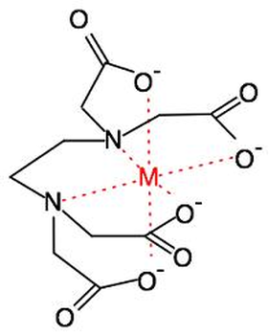
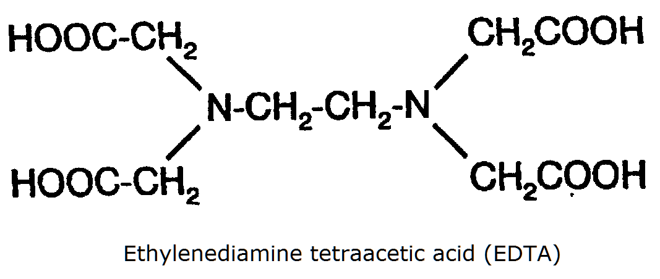
Chelation Chemistry
Chelation: process of chemically sequestering a metal cation for the purpose of rendering it (relatively) non-toxic or at least excretable
Chelators: chemicals effectively forming coordinate bonds using negatively charged atoms or atoms with unbonded electron pairs in their valence shell
(e.g., O– and N: atoms in EDTA)
Thiols bind metals also, and dithiols used in chelation

Slide 36
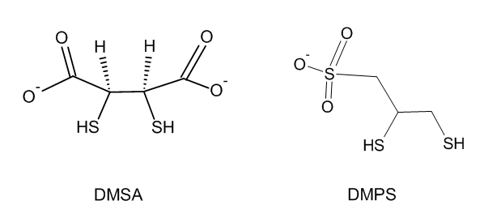
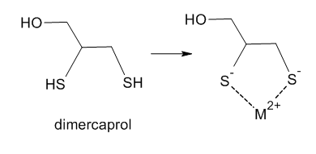
Chelators
Dimercaprol (British anti-Lewisite, BAL)
meso-2,3-Dimercaptosuccinic acid (DMSA)
2,3-dimercapto-propane sulfonate (DMPS)
Penicillamine
EDTA
Generally used for As, Hg, and Pb acute exposures
Chelators include anionic moiety (carboxylate or sulfonate) to promote excretion

Slide 37
Chelation Therapy
Term does not strictly refer to treatments for life-threatening acute (over)exposure to metals
Includes controversial application of chelators to treat heart disease (atherosclerosis) and autism
Chelators quite nonspecific: target & eliminate essential divalent metal cations (Ca, Mg, Fe) which are vital in all cell processes, particularly myocardial function
Systemic therapy to be used only in life-threatening metal-caused exposures

Slide 38
Organic Solvents
aliphatic alcohols
ethyl alcohol
methyl alcohol
chlorinated aliphatics
carbon disulfide (CS₂)
glycols
aromatic hydrocarbons
benzne
alkylbenzenes: toluene, xylenes

Slide 39
Organic Solvents
Aliphatic Alcohols
effects of acute and chronic exposure to ethyl alcohol covered elsewhere
methyl alcohol (methanol), or "wood alcohol," can be absorbed through skin, lungs, and GI tract and can cause blindess even in small doses as retinal neurons are particularly sensitive
Chlorinated Aliphatics
chloroform (CHCl₃) had been used as an anesthetic until early 1900s, but it is toxic to kidneys, liver and heart
carbon tetrachloride (CCl₄) is a dry cleaning solvent and highly toxic to liver, probably because it depletes CYP enzymes and leaves liver vulnerable to other toxicants

Slide 40
Organic Solvents
Carbon Disulfide
CS₂ is used in cellophane & semiconductor production (sometimes pesticides as well)
It is inhaled, biotransformed into sulfur-containing metabolites excreted in urine
In brain, CS₂ can cause severe toxicity with brain damage, sleep disturbances, memory loss, Parkinson's disease-like symptoms
Glycols
ethylene, propylene, and diethylene glycols are ingredients in automobile anti-freeze

Slide 41
Air Pollution
Nitrogen oxides (NO_{x})
NO (nitric oxide), NO₂, N₂O (nitrous oxide), N₂O₂ (dinitrogen dioxide), NO₃ (nitrogen trioxide), N₂O₃ (diN triO), N₂O₄ (diN tetraO), N₂O₅ (diN pentO)
route of entry by inhalation (all gases)
NO₂ may reduce lymphocyte counts, increase susceptibility to infection, sensitize lung tissue with damaging inflammatory response, alter cellular architecture in alveoli
NO is produced in body as signal mediator: action of nitroglycerine to cause strong vasodilation is via NO
what effect is there as an air pollutant?

Slide 42
Air Pollution
Ozone (O₃)
Produced in photochemical smog
Strongly reactive with C=C: unsaturated fatty acids a target, forming lipid peroxides
Forms reactive oxygen species: singlet oxygen, OH radicals, H₂O₂, which attack DNA, other biomolecules
Acute exposure cause injury/death upper respiratory epithelial cells with exudates & inflammation, which resolves in about a week
Poorly absorbed in lungs, so does not distribute well throughout body

Slide 43
Air Pollution
Sulfur dioxide (SO₂)
Highly water soluble: inhalation exposures generally confined to upper airways
Irritation caused by forming acids when reacted with H₂O
Acute overexposure may induce a bronchoconstriction and also diminish pulmonary defense (mucociliary transport, alveolar clearance of deposited particles, and macrophage function)

Slide 44
Air Pollution
Particulates
Many airborne particles carry toxic substances on their surface
Toxic metal exposure by inhalation results from metals covering surface of particles

Slide 45

maximum daily dose (MDD) [mg/kg/day]
lifetime average daily dose (LADD) [mg/kg/day/lifteime]
Risk [R] = Toxicity [T] × Exposure [E]
Risk [R] = Toxicity [T] × f(Exposure [E])
f(E) = function of exposure, usually log scaled
Safety = 1 ÷ P(R) = inverse of the probability of risk
$SHD= \frac{{ED}_{0.0}×A_{t/h}×T_{{1/2}_{t/h}}×Wt×D_{t/h}}{SF} \text{(}\frac{\text{mg}}{\text{day}}\text{)}$ where SHD = safe human dose, ED0.0 = NOEL, A_{t/h} = ratio of absorption of toxicant in test organism and human, T_{1/2t/h} = ratio of half-life of toxicant in test organism and human, Wt = weight of exposed individual, ratio of toxicant test dosages in animals to exposure dosages in humans, SF = safety factor

Slide 46
Environmental Persistence
"Persistent" toxicants distribute quickly to "low metabolic turnover" storage depots
lipophilic substances to adipose tissue
Become part of food chain or web
Bioamplification
increase in stored mass of toxicant in organism at higher level in food chain or web
Biomagnification
synonym for bioamplification
Bioaccumulation
toxicant shows increase in levels in tissue faster than is removed
Bioconcentration
A toxic solute bioaccumulated from an aqueous solution

Slide 47
Sources
WW Hughes, Essentials of Environmental Toxicology: The Effects of Environmentally Hazardous Substances on Human Health, (Philadelphia: Taylor & Francis), 1996
SM Roberts, RC James, PL Williams, eds., Principles of Toxicology: Environmental and Industrial Applications, 3rd Ed, (Wiley), 2015
DL Costa, "Air Pollution," Chap 28 in CD Klaassen, ed., Casarett and Doull's Toxicology: The Basic Science of Poisons, 7th Ed (New York: McGraw-Hill), 2008

Slide 48
Group Work
Research access to assessment protocols, laboratories and specific analyses for management of toxic exposure
Review these with instructor
Take-home midterm to be posted to MOODLE

